Slide 1

PID Controllers
Make Your Robots Move Smoothly and Accurately

Slide 2
Why Control Systems Matter
Rovers veer off track or overshoot
Control systems maintain desired behavior (speed, position, heading)
Like Adaptive Cruise Control in cars
PID lets the robot self-correct using sensor feedback.

Slide 3
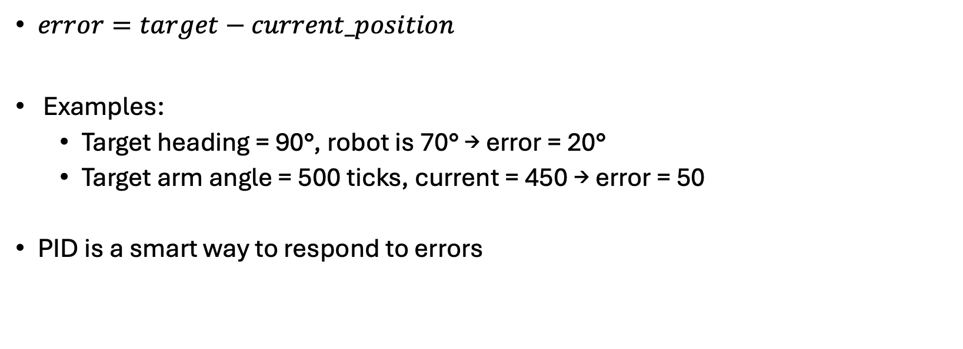
Errors in a System
$error=target−current_position$
Examples:
  Target heading = 90°, robot is 70° → error = 20°
  Target arm angle = 500 ticks, current = 450 → error = 50
PID is a smart way to respond to errors

Slide 4
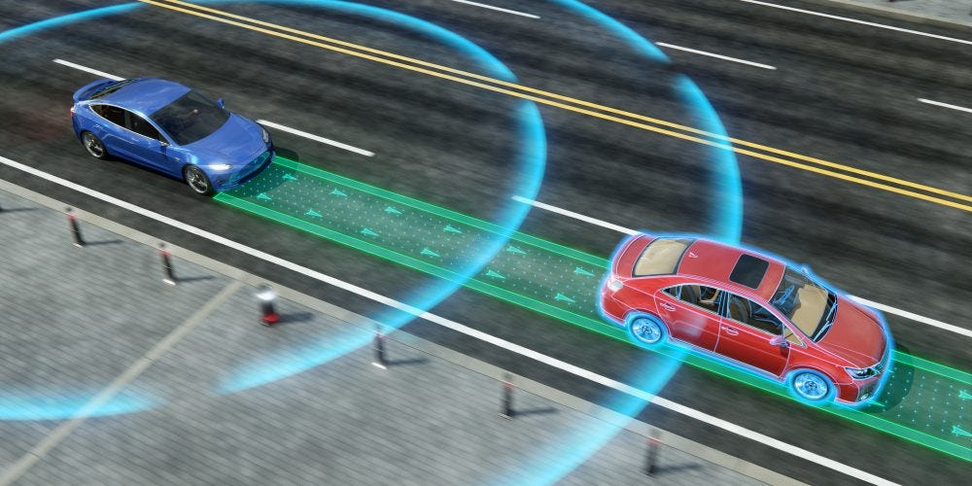
PID
It’s a feedback control loop used to minimize error
Proportional (P): Responds to current error
Integral (I): Fixes accumulated past error
Derivative (D): Predicts future error
Analogy – maintain blue car at a set distance from the red car in cruise control

Slide 5
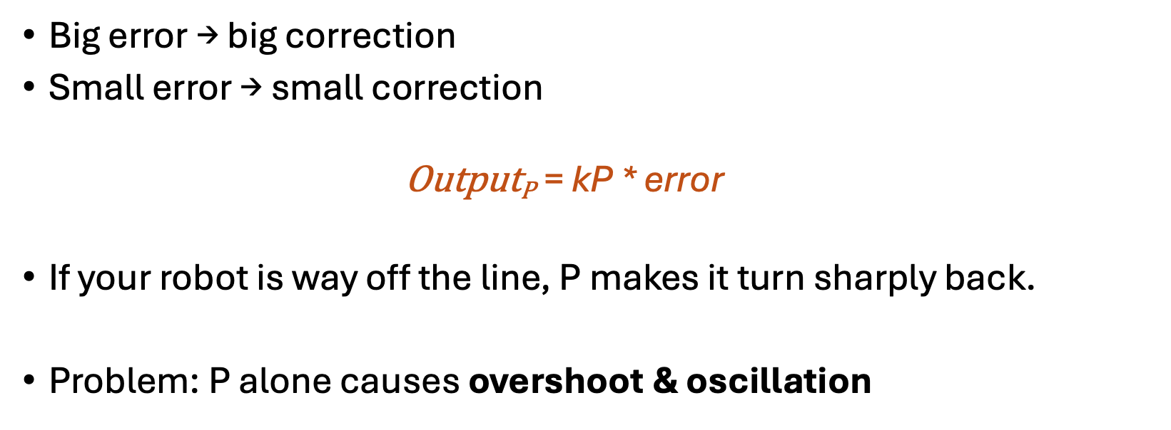
Proportional (P) – Push harder when you are far
Big error → big correction
Small error → small correction
  $$\text{O}\text{utput}\text{P}\text{ =} \text{kP}\text{ ∗ }\text{error}$$
If your robot is way off the line, P makes it turn sharply back.
Problem: P alone causes overshoot & oscillation

Slide 6
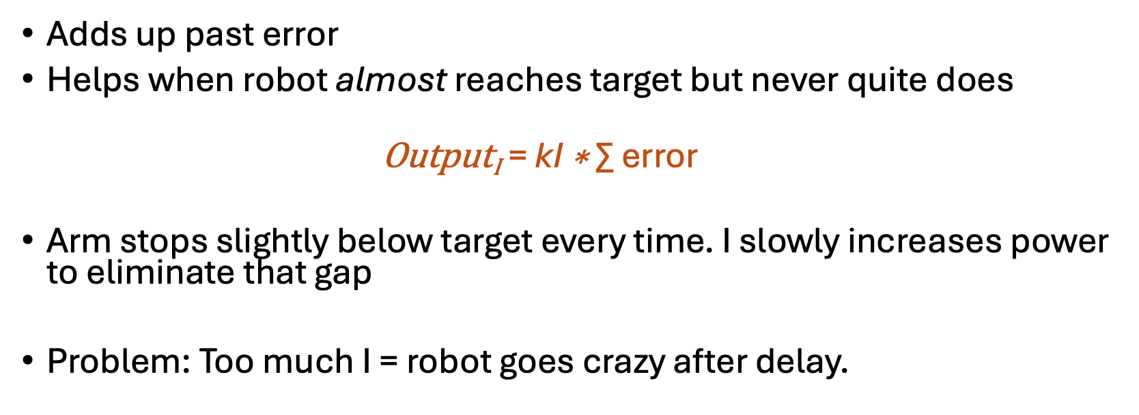
Integral (I) – Fix Long-term Biases
Adds up past error
Helps when robot almost reaches target but never quite does
  $$\text{O}\text{utput}\text{I}\text{ =} \text{kI}\text{ ∗} \text{∑} \text{error}$$
Arm stops slightly below target every time. I slowly increases power to eliminate that gap
Problem: Too much I = robot goes crazy after delay.

Slide 7
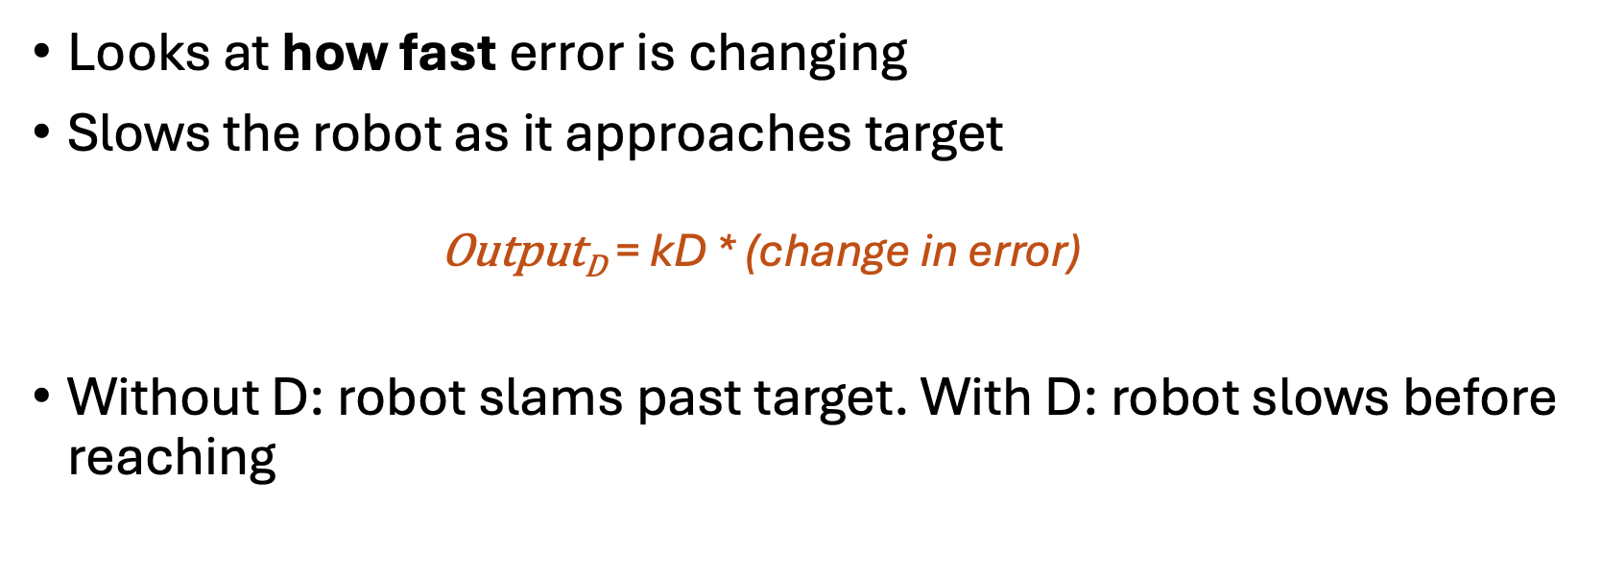
Derivative (D) – The Brake Pedal
Looks at how fast error is changing
Slows the robot as it approaches target
  $$\text{Output}\text{D}\text{ = }\text{kD}\text{ ∗ (}\text{change} \text{in} \text{error}\text{)}$$
Without D: robot slams past target. With D: robot slows before reaching

Slide 8
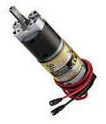
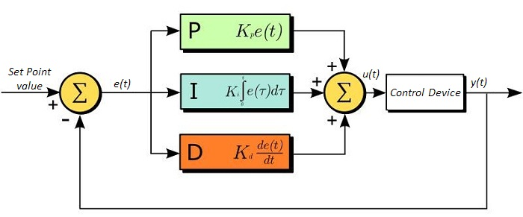
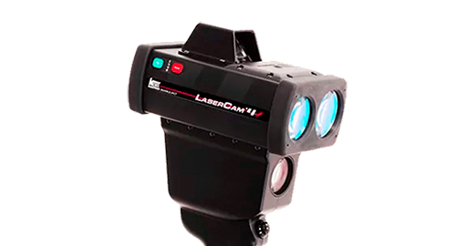
PID Equation
e(t) = error & K_{p}, K_{i}, K_{d} = tuning constants

Slide 9

PID Equation
$$\text{o}\text{utput}\text{ = }\text{kP} \text{⋅} \text{error}\text{ + }\text{kI}\text{ ⋅ ∑ }\text{error}\text{ + }\text{kD}\text{ ⋅ }\text{Δ} \text{erro}\text{r}$$

Slide 10
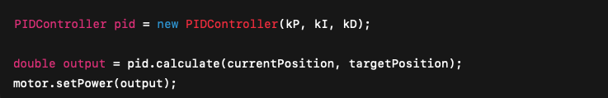
PID in FTCLib

Slide 11
Where to use PID
Arm position
Slides
Heading hold (gyro)
Driving straight
April Tag alignment

Slide 12
PID Tuning - Steps
Start with P only
Increase P until oscillation
Add D to reduce oscillation
Add small I only if needed

